Slide 1
Disclaimer
Thank you for your interest in using Google Cloud training material. We are excited about the content we are able to provide you (collectively, “Teaching Resources”) and hope you are too.
By using Teaching Resources, you agree to be bound by all of the following terms, as well as the Google terms of service and the Google privacy policy. Unless otherwise specified, terms used below will have the meanings described in the Google terms of service.
Educational Use Only. Teaching Resources is intended only for use teaching courses at regionally accredited or higher learning institutions. The content may be adapted, customize, remixed, and shared for educational use. Content may not be distributed, or otherwise exploited for any commercial purpose, commercial advantage, or private monetary compensation.
Attribution Requirements. If you distribute, publicly perform, display, transmit, publish, or otherwise make available any Teaching Resources or any derivative works thereof, you must attribute the material you use back to the Teaching Resources, but not in any way that suggests Google, any of its affiliates, or any of its third party content providers endorse you or your use of such materials. If you adapt, remix, or customize the Teaching Resources please include the following text on each edited slide: “The original content was provided by Google LLC and modified for the purpose of the course, without input or endorsement from Google LLC.”
Descriptions of Google products, services, infrastructure and processes contained in the Teaching Resources are descriptions for teaching and learning purposes only and do not constitute a guarantee, promise, or representation of accuracy by Google. Pricing, availability or features of Google Cloud products and services described in the Teaching Resources may change.
Copyright Google LLC. For educational purposes in accordance with the terms of use set forth on the program Website.

Slide 2
Where Do I Store This Stuff?
Copyright Google LLC. For educational purposes in accordance with the terms of use set forth on the program Website.
Notes:
Welcome to Where Do I Store This Stuff?, I’m ______. In this module, we’ll look at how we can take advantage of managed storage and databases for cloud applications.

Slide 3
Course map
Module 1
Module 2
Module 3
Module 4
Module 5
So, What’s the Cloud Anyway?
Start with a Solid Platform
Use Google Cloud to Build Your Apps
Where Do I Store This Stuff?
There’s an API for That!
Module 6
Module 7
Module 8
Module 9
Module 10
You Can’t Secure the Cloud, Right?
It Helps to Network
Let Google Keep an Eye on Things
You Have the Data, but What Are You Doing with It?
Let Machines Do the Work
Google Cloud skills badges
Copyright Google LLC. For educational purposes in accordance with the terms of use set forth on the program Website.
Notes:
So far in this course, we’ve learned what Google Cloud is, found out why we should have a solid platform before beginning a Google Cloud transfer; and learned how Google Cloud supports the building of apps. In this module, we’ll find out everything we need to know about storage and database options in Google Cloud.

Slide 4
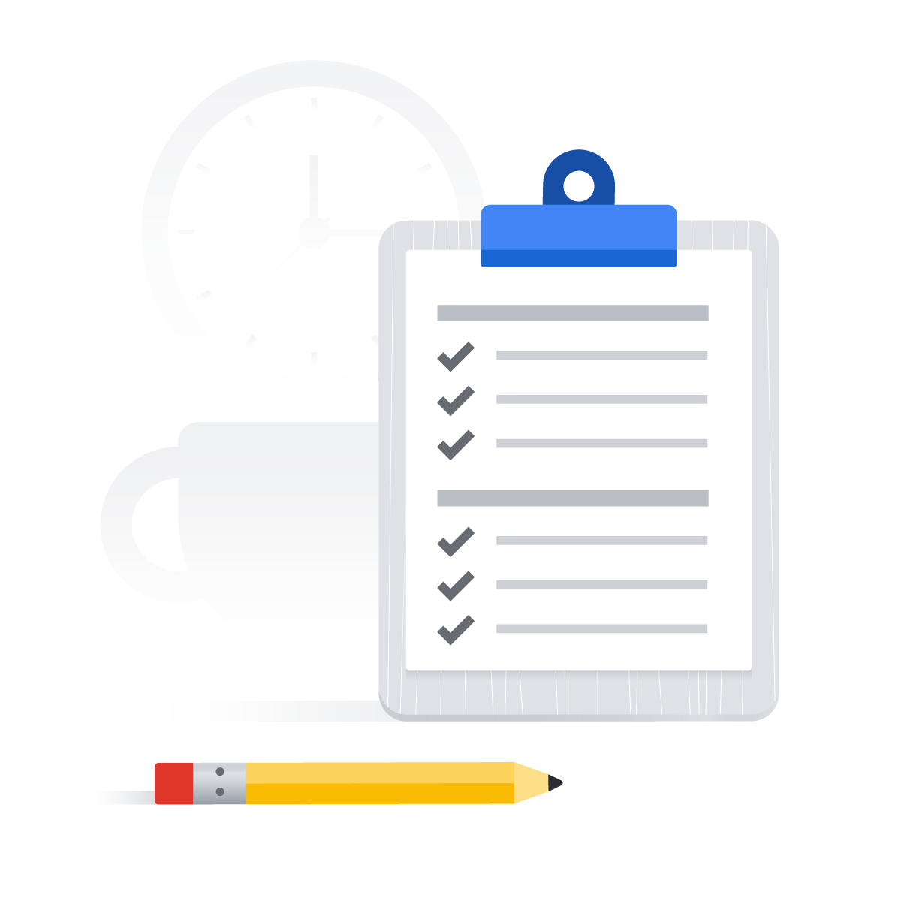
Learn how to ... (1/2)
Implement a variety of structured and unstructured storage models
Compare and contrast the different Cloud Storage options
Distinguish between structured and unstructured storage options in the cloud
Compare the role of the different Cloud Storage options
Copyright Google LLC. For educational purposes in accordance with the terms of use set forth on the program Website.
Notes:
The objective of this module is for you to be able to implement a variety of structured and unstructured storage models.
The specific learning objectives to achieve this include you being able to discuss the different storage options that exist in the cloud, explain the role of structured and unstructured storage in the cloud, and compare the role of the different Cloud Storage options.

Slide 5
Learn how to ... (2/2)
Explore the use case for Relational versus NoSQL storage options
Describe leveraging Cloud Storage as an unstructured storage option
Explain relational database options in the cloud
Describe the NoSQL options in Google Cloud
Copyright Google LLC. For educational purposes in accordance with the terms of use set forth on the program Website.
Notes:
You’ll also be able to explore the use case for Relational versus NoSQL storage, describe leveraging Cloud Storage as unstructured storage, explain relational database choices in the cloud, and describe the NoSQL options in Google Cloud.

Slide 6
Agenda (1/3)
Storage Options in the Cloud
Structured and Unstructured Storage in the Cloud
Unstructured Storage using Cloud Storage
Lab: Cloud Storage: Qwik Start - CLI/SDK
SQL Managed Services
Copyright Google LLC. For educational purposes in accordance with the terms of use set forth on the program Website.
Notes:
Here’s the agenda for this module. We’ll begin by learning about different storage options in the cloud, which includes structured and unstructured storage. Next, we’ll learn how to leverage unstructured storage using Cloud Storage and complete a hands-on lab that explores a range of activities applicable to Cloud Storage. We’ll move on to understanding the use case for SQL managed services.

Slide 7
Agenda (2/3)
Exploring Cloud SQL
Lab: Cloud SQL for MySQL: Qwik Start
Cloud Spanner as a Managed Service
NoSQL Managed Services Options
Datastore, a NoSQL Document Store
Copyright Google LLC. For educational purposes in accordance with the terms of use set forth on the program Website.
Notes:
Next, we’ll explore Cloud SQL before completing another lab where we’ll create and connect to a Google Cloud SQL MySQL instance and perform basic SQL operations using the Cloud Console and the mysql client. We’ll discover how to leverage Cloud Spanner and explore the available NoSQL options. We’ll then discuss using Datastore as a NoSQL document store.

Slide 8
Agenda (3/3)
Cloud Bigtable as a NoSQL Option
Quiz
Summary
Copyright Google LLC. For educational purposes in accordance with the terms of use set forth on the program Website.
Notes:
We’ll complete the module by describing how Cloud Bigtable can be leveraged as a NoSQL option.

Slide 9
Agenda
Storage Options in the Cloud
Structured and Unstructured Storage in the Cloud
Unstructured Storage using Cloud Storage
Lab: Cloud Storage: Qwik Start - CLI/SDK
SQL Managed Services
Copyright Google LLC. For educational purposes in accordance with the terms of use set forth on the program Website.
Notes:
Let’s start with our first topic, which explores the different storage options that exist in the cloud.

Slide 10
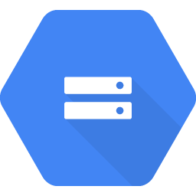
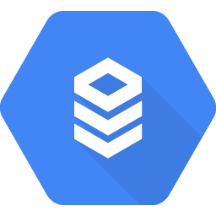
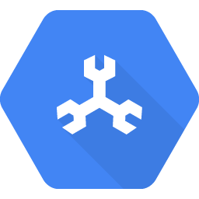
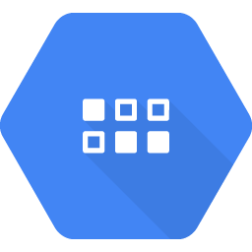
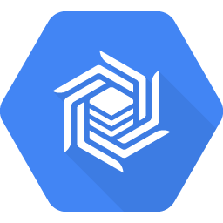
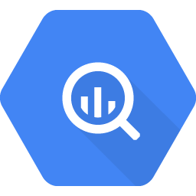
Google Cloud has many storage options
Compute
Networking
Big data
Machine learning
Storage
Operations and tools
Relational databases
Non-relational databases
Data warehousing
Cloud
Storage
Cloud
SQL
Cloud
Spanner
Datastore
Cloud Bigtable
BigQuery
Copyright Google LLC. For educational purposes in accordance with the terms of use set forth on the program Website.
Notes:
Google Cloud offers many different storage options from object storage to database services. These options help users save costs, reduce the time it takes to launch, and make the most of their datasets by being able to analyze a wide variety of data.
All applications create and use data. Google provides all the tools needed to build and move applications to the cloud. This includes storing videos, images and other objects, even operational application data.
Applications, in many cases, require a storage solution and Google Cloud provides managed services that are scalable, reliable ,and easy to operate. For relational databases, which are commonly used today, Google offers a Cloud SQL for MySQL in Postgres, as well as Cloud Spanner. Google also have non-relational, or NoSQL databases like Datastore and Cloud Bigtable.
BigQuery is a highly scalable enterprise data warehouse, and falls outside of the storage solutions discussed in this module.

Slide 11
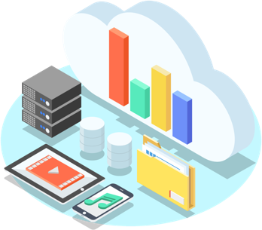
There are three common use cases for cloud storage
1
Content storage and delivery
Storage for data analytics and general compute
2
3
Backup and archival storage
Copyright Google LLC. For educational purposes in accordance with the terms of use set forth on the program Website.
Notes:
For cloud storage, there are three common use cases. The first is content storage and delivery. This is when users have content such as images or videos and they serve that content to end users wherever they are. People want their content fast, so running on the global network that Google provides makes for a great experience for end users.
The second use case is storage for data analytics and general compute. Users can process or expose their data to analytics tools like the analytics stack of products that Google Cloud offers and do things like genomic sequencing or IOT data analysis.
The third use case is backup and archival storage. Users can save storage costs by migrating infrequently accessed content to cheaper cloud storage options. Also, if anything happens to their data on-premises, it's critical to have a copy in the cloud for recovery purposes.

Slide 12

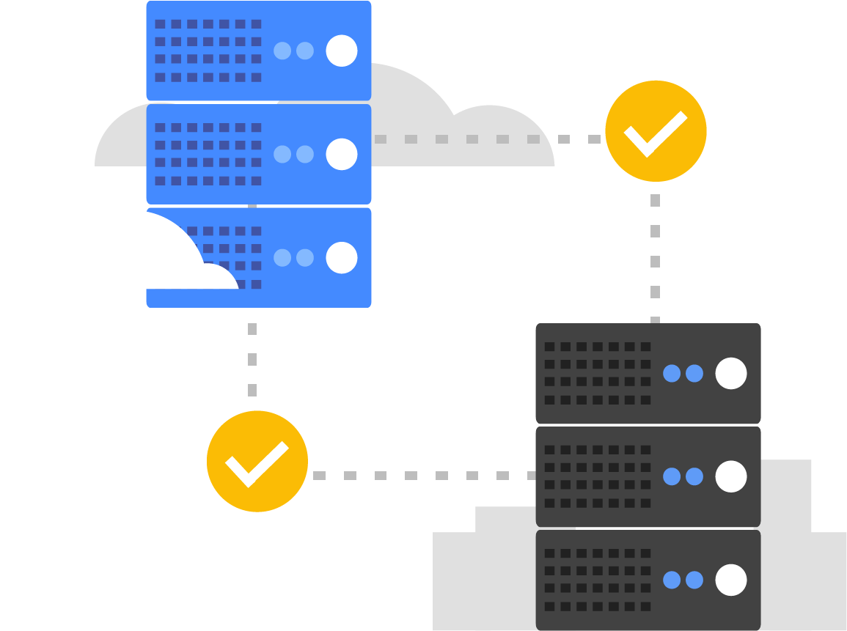
For users with databases, Google has two priorities
Migrate existing databases to the cloud, and move them to the right service.
Innovate, build, or rebuild for the cloud, take advantage of mobile, and plan for future growth.
Copyright Google LLC. For educational purposes in accordance with the terms of use set forth on the program Website.
Notes:
For users with databases, Google’s first priority is to help them migrate existing databases to the cloud and move them to the right service. This will usually be users moving MySQL or Postgres workloads to Cloud SQL. The second priority is to help users innovate, build or rebuild for the cloud, take advantage of mobile, and plan for future growth.

Slide 13
Agenda
Storage Options in the Cloud
Structured and Unstructured Storage in the Cloud
Unstructured Storage using Cloud Storage
Lab: Cloud Storage: Qwik Start - CLI/SDK
SQL Managed Services
Copyright Google LLC. For educational purposes in accordance with the terms of use set forth on the program Website.
Notes:
Now we’ll look at how to choose between structured and unstructured storage in the cloud.

Slide 14
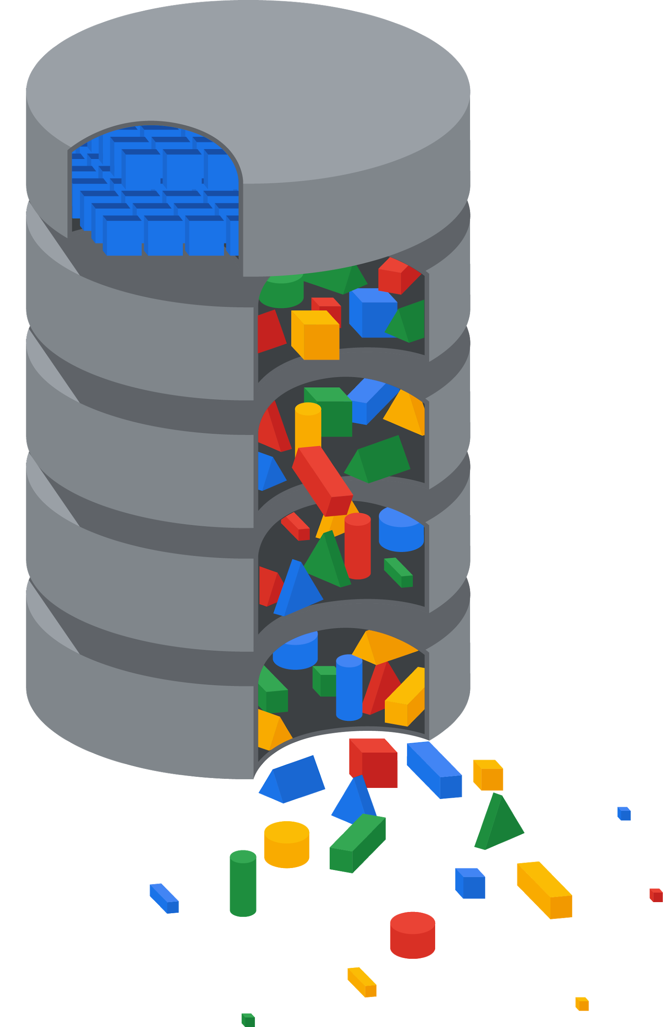
Structured versus unstructured data
Unstructured data
Transactions
First_Name | Last_Name | Address | City | Age
Sherlock | Holmes | 12 Main St | Mesa | 60
James | Bond | 23 Old St | Napa | 43
Scarlett | O’Hara | 34 New St | Derby | 23
Marge | Simpson | 56 West St | Cody | 36
Voice transcriptions
Online communities
Notes & text fields
Structured data
Ratings & reviews
Social media
Call center
Email
Chat
Surveys
Copyright Google LLC. For educational purposes in accordance with the terms of use set forth on the program Website.
Notes:
Structured data is what most people are used to working with and typically fits within columns and rows in spreadsheets or relational databases. You can expect this type of data to be organized and clearly defined, and usually easy to capture, access and analyze. Examples of structured data would include names, addresses, contact numbers, dates and billing info. The benefit of structured data is that it can be understood by programming languages and data can be manipulated relatively quickly.
It’s estimated that around 80 percent of all data is unstructured. It’s far more difficult to process or analyze unstructured data using traditional methods as there’s no internal identifier to enable search functions to identify it. Unstructured data often includes text and multimedia content, for example, e-mail messages, documents, photos, videos, presentations, webpages, and so on. Organizations are focusing increasingly on mining unstructured data for insights that will provide them with a competitive edge.

Slide 15
What type of storage will meet my needs best?
Is your data structured?
No
?
Yes
Cloud Storage
Is your workload analytics?
?
Yes
No
Do you need horizontal scalability?
Is your data relational?
Do you need updates or low latency?
?
Yes
?
?
No
Yes
No
Yes
No
Cloud SQL
Cloud Spanner
Datastore
Cloud Bigtable
BigQuery
Copyright Google LLC. For educational purposes in accordance with the terms of use set forth on the program Website.
Notes:
This flowchart shows the decision tree for determining, based on use case, which storage solution should be utilized. If you need a solution to hold files, backups, logs, and blobs for example, a good unstructured solution would be Cloud Storage.
If you need a structured solution, and are utilizing workload analytics, BigQuery and Cloud Bigtable are two options. If a relational database is needed, then you can choose either a traditional managed MySQL or PostGres database using Cloud SQL, or use a horizontally scalable, highly available database like Cloud Spanner.
If you need a simple NoSQL option to use for your application, Datastore is a solid choice. The following topics will cover each choice in more detail.

Slide 16
Agenda
Storage Options in the Cloud
Structured and Unstructured Storage in the Cloud
Unstructured Storage using Cloud Storage
Lab: Cloud Storage: Qwik Start - CLI/SDK
SQL Managed Services
Copyright Google LLC. For educational purposes in accordance with the terms of use set forth on the program Website.
Notes:
In this topic, we’ll discuss how you can leverage unstructured storage using Cloud Storage.

Slide 17
Cloud Storage in Google Cloud
Relational
Non-relational
Object
Warehouse
Cloud
SQL
Cloud
Spanner
Datastore
Cloud Bigtable
Cloud
Storage
BigQuery
Copyright Google LLC. For educational purposes in accordance with the terms of use set forth on the program Website.
Notes:
Cloud Storage is just one of many storage options on Google Cloud and stores and serves object data, also known as blob data.

Slide 18



Google uses Cloud Storage too!
Copyright Google LLC. For educational purposes in accordance with the terms of use set forth on the program Website.
Notes:
You can store an unlimited number of objects, up to 5 terabytes in size each, and Cloud Storage is well suited to binary or object data such as images, media serving, and backups.
Cloud Storage is the same storage that Google uses for images in Google Photos, Gmail attachments, Google Docs, and so on.

Slide 19
Cloud Storage offers different classes of storage
Storage Class | Minimum duration | Availability SLA | Typical monthly availability | Use cases | Name for APIs and gsutil
Standard Storage | None | Multi-region 99.95% Dual-region 99.95% Region 99.9% | >99.99% availability in multi-regions and dual-regions; 99.99% in regions | Access data frequently ("hot" data) and/or store for brief periods Serve website content Stream videos Interactive workloads Mobile and gaming apps | STANDARD
Nearline Storage | 30 days | Multi-region 99.9% Dual-region 99.9% Region 99.0% | 99.95% availability in multi-regions and dual-regions; 99.9% in regions | Read/modify data ≤ once per month Data backup Serve long-tail multimedia content | NEARLINE
Coldline Storage | 90 days |  |  | Read/modify data no more than once a quarter | COLDLINE
Archive Storage | 365 days | None |  | Read/modify data < once a year Cold data storage Disaster recovery | ARCHIVE
Copyright Google LLC. For educational purposes in accordance with the terms of use set forth on the program Website.
Notes:
Users have a variety of storage requirements for a multitude of use cases. Google offers different classes of Cloud Storage to cater for these requirements. The classes are based on how often data is accessed.
Standard Storage is best for data that is frequently accessed ("hot" data) and/or stored for only brief periods of time. When used in a region, co-locating your resources maximizes the performance for data-intensive computations and can reduce network charges. When used in a dual-region, you still get optimized performance when accessing Google Cloud products that are located in one of the associated regions, but you also get the improved availability that comes from storing data in geographically separate locations. When used in a multi-region, Standard Storage is appropriate for storing data that is accessed around the world, such as serving website content, streaming videos, executing interactive workloads, or serving data supporting mobile and gaming applications.
Nearline Storage is a low-cost, highly durable storage service for storing infrequently accessed data. Nearline Storage is a better choice than Standard Storage in scenarios where slightly lower availability, a 30-day minimum storage duration, and costs for data access are acceptable trade-offs for lowered at-rest storage costs. Nearline Storage is ideal for data you plan to read or modify on average once per month or less. Nearline Storage is appropriate for data backup, long-tail multimedia content, and data archiving.
Coldline Storage is a very-low-cost, highly durable storage service for storing infrequently accessed data. Coldline Storage is a better choice than Standard Storage or Nearline Storage in scenarios where slightly lower availability, a 90-day minimum storage duration, and higher costs for data access are acceptable trade-offs for lowered at-rest storage costs. Coldline Storage is ideal for data you plan to read or modify at most once a quarter.
Archive Storage is the lowest-cost, highly durable storage service for data archiving, online backup, and disaster recovery. Archive Storage has higher costs for data access and operations, as well as a 365-day minimum storage duration. Archive Storage is the best choice for data that you plan to access less than once a year. For example, cold data storage, such as data stored for legal or regulatory reasons, and disaster recovery.
Cloud Storage is unique in a number of ways, it has a single API, millisecond data access latency, and eleven 9s durability across all storage classes. Cloud Storage also offers object lifecycle management, which uses policies to automatically move data to lower cost storage classes as it is accessed less frequently throughout its life.
For more information, see: https://cloud.google.com/storage/docs/storage-classes

Slide 20

Cloud Storage files are organized into buckets
Globally unique name
Location (region, dual-region, or multi-region)
Storage class
IAM policies or access-control lists
Object versioning setting
Object lifecycle management rules
Copyright Google LLC. For educational purposes in accordance with the terms of use set forth on the program Website.
Notes:
Cloud Storage files are organized into buckets. When you create a bucket, you give it a globally-unique name, you specify a geographic location where the bucket and its contents are stored, and you choose one of the default storage classes we just discussed.
There are several ways to control users’ access to your objects and buckets. For most purposes, Cloud IAM is sufficient. Roles are inherited from project to bucket to object. If you need finer control, you can create access control lists. ACLs define who has access to your buckets and objects, as well as what level of access they have. Each ACL consists of two pieces of information: A scope, which defines who can perform the specified actions and a permission, which defines what actions can be performed, for example, read or write.
You can turn on object versioning on your buckets if you want. If you do, Cloud Storage keeps a history of modifications--that is, overwrites or deletes--of all objects in the bucket. You can list the archived versions of an object, restore an object to an older state, or permanently delete a version, as needed. If you don’t turn on object versioning, new always overwrites old.
Cloud Storage also offers lifecycle management policies. For example, you could tell Cloud Storage to delete objects older than 365 days, or to delete objects created before January 1, 2013; or to keep only the 3 most recent versions of each object in a bucket that has versioning enabled.

Slide 21
Agenda
Storage Options in the Cloud
Structured and Unstructured Storage in the Cloud
Unstructured Storage using Cloud Storage
Lab: Cloud Storage: Qwik Start - CLI/SDK
SQL Managed Services
Copyright Google LLC. For educational purposes in accordance with the terms of use set forth on the program Website.
Notes:
We’ll now complete a short activity based on Cloud Storage.

Slide 22
Lab Intro
Cloud Storage: Qwik Start - CLI/SDK
Create a storage bucket, upload objects, create folders and subfolders, and make objects publicly accessible using the Google Cloud command line.
You can find the lab here.
Copyright Google LLC. For educational purposes in accordance with the terms of use set forth on the program Website.
Notes:
In this lab, we’ll create a storage bucket, upload objects, create folders and subfolders, and make objects publicly accessible using the Google Cloud command line.

Slide 23
Lab objectives
Upload an object to a bucket.
Download an object from a bucket.
Copy an object to a folder in the bucket.
List contents of a bucket or folder.
List details for an object.
Make an object publicly accessible.
Copyright Google LLC. For educational purposes in accordance with the terms of use set forth on the program Website.
Notes:
By completing the lab, you will upload an object to a bucket, download an object from a bucket, copy an object to a folder in the bucket, list contents of a bucket or folder, list details for an object, and make an object publicly accessible.

Slide 24
Lab Intro
Cloud Storage: Qwik Start - Cloud Console (Alternative)
Use the Cloud Console to create a storage bucket, then upload objects, create folders and subfolders, and make those objects publicly accessible.
You can find the lab here.
Copyright Google LLC. For educational purposes in accordance with the terms of use set forth on the program Website.
Notes:
In this lab, we’ll use the Cloud Console to create a storage bucket, then upload objects, create folders and subfolders, and make those objects publicly accessible.

Slide 25
Lab objectives
Create a storage bucket.
Upload an object to the bucket.
Make an object publicly accessible.
Create and delete folders.
Copyright Google LLC. For educational purposes in accordance with the terms of use set forth on the program Website.
Notes:
By completing the lab, you will create a storage bucket, upload an object to the bucket, make an object publicly accessible, and create and delete folders.

Slide 26
Agenda
Storage Options in the Cloud
Structured and Unstructured Storage in the Cloud
Unstructured Storage using Cloud Storage
Lab: Cloud Storage: Qwik Start - CLI/SDK
SQL Managed Services
Copyright Google LLC. For educational purposes in accordance with the terms of use set forth on the program Website.
Notes:
In this topic, we’ll discuss the use case for SQL managed services. But before we do, let’s revisit what a database is and how it’s used.

Slide 27
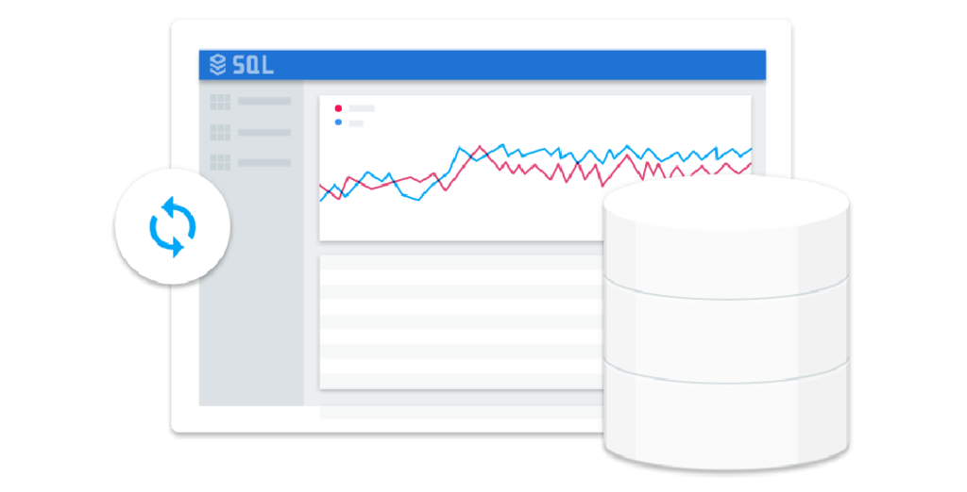
What is a database and how is it used?
A collection of information organized so that it can easily be accessed and managed.
Computer applications run databases to get a fast answer to questions.
Copyright Google LLC. For educational purposes in accordance with the terms of use set forth on the program Website.
Notes:
A database is a collection of information that is organized so that it can easily be accessed and managed. Users are building software applications using databases to answer business questions, such as buying a ticket, filing an expense report, storing a photo, or storing medical records. Computer applications run databases to get a fast answer to questions like:
What’s this user’s name given their sign-in information so I can display it?
What’s the cost of product Y so I can show it on my dynamic webpage?
What were my top 10 best selling products this month?
What is the next ad I should show the user currently browsing my site?
These apps must be able to write data in and read data out of databases. When a database is used, it’s usually run by a computer application. So when we say that “a database is useful for doing X,” it’s usually because it’s designed to make answering a question simply, fast, and efficient for the app.

Slide 28
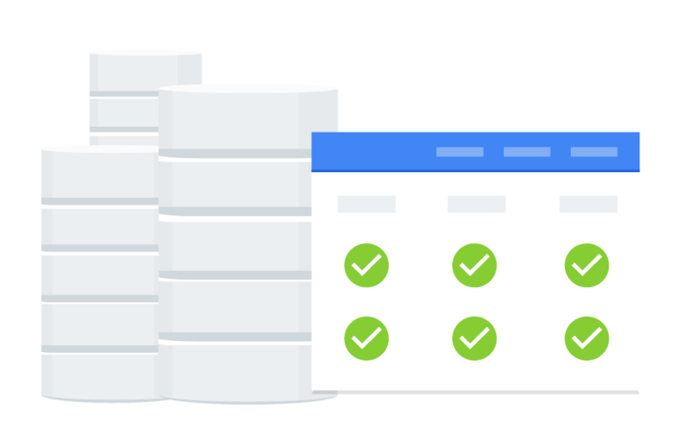
Relational databases are the most common
Relational database management systems
= RDBMS
= relational databases
= SQL databases
Suitable use cases:
Have a well-structured data model.
Need transactions.
Ability to join data across tables to retrieve complex data combinations.
Copyright Google LLC. For educational purposes in accordance with the terms of use set forth on the program Website.
Notes:
Relational database management systems, abbreviated RDBMS, or just relational databases, are used extensively and are the kind of database you encounter most of the time. They’re organized based on the relational model of data.
They are very good when you have a well-structured data model and when you need transactions and the ability to join data across tables to retrieve complex combinations of your data.
Because they make use of the Structured Query Language, they are sometimes called SQL databases.

Slide 29
Options for SQL-based managed services
Cloud SQL
MySQL, PostgreSQL, and SQL Server databases as a service
Automatic replication
Managed backups
Vertical scaling (read and write)
Horizontal scaling (read)
Cloud Spanner
Automatic replication
Strong global consistency
Managed instances with high availability
SQL (ANSI SQL 2011 with extensions)
Copyright Google LLC. For educational purposes in accordance with the terms of use set forth on the program Website.
Notes:
Google Cloud offers two managed relational database services. Cloud SQL offers managed MySQL, PostgresSQL, and SQL Server databases as a service. When setting up Cloud SQL with replicas, replication is automatic. The infrastructure of this database is managed. This will include backups, updates, failover, and maintenance. You are still responsible for user, schema, and data management. The database can scale horizontally for reads using read replicas, For writes you will have to make the database larger, which usually requires a reboot.
Cloud Spanner is a strongly consistent, horizontally scalable, managed relational database. This service can run your database across multiple nodes, either within a single region or to multiple regions. The managed service automatically replicates data to the nodes. Spanner is ANSI SQL 2011 compliant with extensions.

Slide 30
Agenda
Exploring Cloud SQL
Lab: Cloud SQL for MySQL: Qwik Start
Cloud Spanner as a Managed Service
NoSQL Managed Services Options
Datastore, a NoSQL Document Store
Copyright Google LLC. For educational purposes in accordance with the terms of use set forth on the program Website.
Notes:
Let’s explore Cloud SQL in more detail.

Slide 31
Cloud SQL in Google Cloud
Relational
Non-relational
Object
Warehouse
Cloud
SQL
Cloud
Spanner
Datastore
Cloud Bigtable
Cloud
Storage
BigQuery
Copyright Google LLC. For educational purposes in accordance with the terms of use set forth on the program Website.
Notes:
Cloud SQL is a fully managed, relational database service that makes it easy to set up, maintain, manage, and administer relational MySQL and PostgreSQL databases in the cloud. This allows you to focus on your applications. Cloud SQL is perfect for WordPress sites, ecommerce applications, CRM tools, geospatial applications, and any other application that is compatible with MySQL, PostgreSQL, or SQL Server.

Slide 32
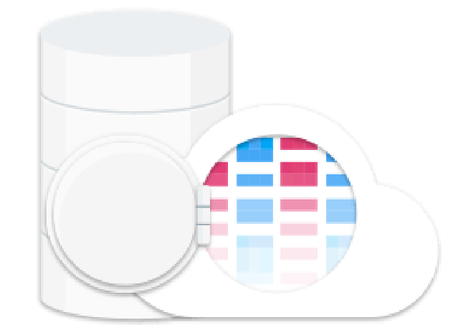
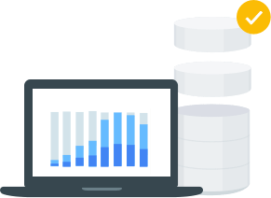
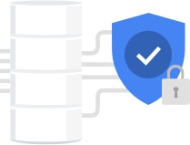
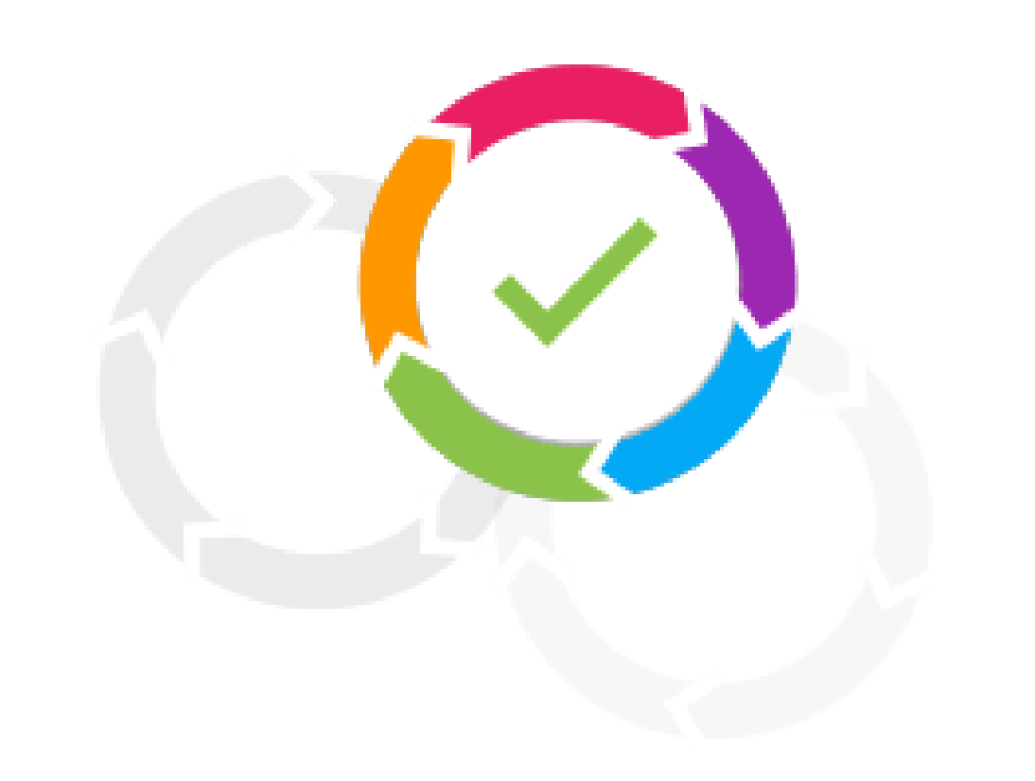
Cloud SQL helps manage mundane
administrative tasks
Fully managed
Performance and scalability
Reliability and security
Compatibility
No software installation.
Automated backups, replication, patches, and updates.
Scales to 64 processor cores and 400+ GB of RAM.
10 TB of storage.
High availability with automatic failovers.
Easily configure replication and backups.
Data is encrypted.
Accessible from almost any app.
Easy to move and migrate data.
Copyright Google LLC. For educational purposes in accordance with the terms of use set forth on the program Website.
Notes:
Cloud SQL doesn’t require any software installation and automates all backups, replication, patches, and updates. This is achieved with greater than 99.95% availability anywhere in the world.
To cater for workloads with different performance demands, Cloud SQL scales up to 64 processor cores and more than 400 GB of RAM per instance. Cloud SQL also provides you with up to 10 TB of storage capacity.
For isolation from failures, high availability provides continuous health-checking and automatically fails over if an instance isn’t healthy. You can also easily configure replication and backups to protect your data. Data is automatically encrypted and Cloud SQL meets applicable compliance requirements.
Cloud SQL instances are accessible from almost any application, anywhere. You can also easily connect from App Engine, Compute Engine, and your workstation. If your app works with MySQL or PostgreSQL, it’ll work with Cloud SQL. It's also easy to move and migrate data through built-in migration tools and standard connection drivers such as MySQL Workbench.

Slide 33
Agenda
Exploring Cloud SQL
Lab: Cloud SQL for MySQL: Qwik Start
Cloud Spanner as a Managed Service
NoSQL Managed Services Options
Datastore, a NoSQL Document Store
Copyright Google LLC. For educational purposes in accordance with the terms of use set forth on the program Website.
Notes:
We’ll now complete a hands-on lab to learn more about using Cloud SQL.

Slide 34
Lab Intro
Cloud SQL for MySQL: Qwik Start
Create and connect to a Google Cloud SQL MySQL instance and perform basic SQL operations using the Cloud Console and the mysql client.
You can find the lab here.
Copyright Google LLC. For educational purposes in accordance with the terms of use set forth on the program Website.
Notes:
In this lab, we’ll create and connect to a Google Cloud SQL MySQL instance and perform basic SQL operations using the Cloud Console and the mysql client.

Slide 35
Lab objectives
Create a Cloud SQL instance.
Connect to an instance using the mysql client in the Cloud Shell.
Copyright Google LLC. For educational purposes in accordance with the terms of use set forth on the program Website.
Notes:
By completing the lab, you will create a Cloud SQL instance and connect to an instance using the mysql client in the Cloud Shell.

Slide 36
Lab Intro
Loading Data into Google Cloud SQL (Alternative)
In this lab, you import data from CSV text files into Cloud SQL and perform basic data analysis using simple queries.
You can find the lab here.
Copyright Google LLC. For educational purposes in accordance with the terms of use set forth on the program Website.
Notes:
In this lab, we’ll import data from CSV text files into Cloud SQL and perform basic data analysis using simple queries.

Slide 37
Lab objectives
Create a Cloud SQL instance.
Create a Cloud SQL database.
Import text data into Cloud SQL.
Build an initial data model using queries.
Copyright Google LLC. For educational purposes in accordance with the terms of use set forth on the program Website.
Notes:
By completing the lab, you will create a Cloud SQL instance as well as a Cloud SQL database, import text data into Cloud SQL, and build an initial data model using queries.

Slide 38
Agenda
Exploring Cloud SQL
Lab: Cloud SQL for MySQL: Qwik Start
Cloud Spanner as a Managed Service
NoSQL Managed Services Options
Datastore, a NoSQL Document Store
Copyright Google LLC. For educational purposes in accordance with the terms of use set forth on the program Website.
Notes:
In this topic, we’ll explore how Cloud Spanner can be leveraged as a managed service.

Slide 39
Cloud Spanner in Google Cloud
Relational
Non-relational
Object
Warehouse
Cloud
SQL
Cloud
Spanner
Datastore
Cloud Bigtable
Cloud
Storage
BigQuery
Copyright Google LLC. For educational purposes in accordance with the terms of use set forth on the program Website.
Notes:
As with Cloud SQL, Cloud Spanner is aligned to relational database requirements. The key difference is that Cloud Spanner combines the benefits of relational database structure with non-relational horizontal scale. Vertical scaling is where you make a single instance larger or smaller. Horizontal scaling is when you scale by adding and removing servers. What makes Cloud Spanner unique is that fact that it is a relational database that scales horizontally.
Cloud Spanner users are often in the advertising, finance, and marketing technology industries, where the need exists to manage end user metadata.

Slide 40
The difference between Cloud Spanner and
other databases
1
Familiar relational database structure
2
Scales to very large databases
3
Strong external consistency
4
Reduces operational overheads
Copyright Google LLC. For educational purposes in accordance with the terms of use set forth on the program Website.
Notes:
Most databases today require making trade-offs between scale and consistency. With Cloud Spanner, users get the best of relational database structure and non-relational database scale and performance with strong external consistency across rows, regions, and continents.
What this means is that Cloud Spanner can scale to very large database sizes while still giving IT and developers the familiarity they are used to with other relational databases such as MySQL, PostgreSQL, or proprietary databases.
Cloud Spanner is strongly consistent. Data added or updated from any location is immediately available regardless of the location it is accessed.
Cloud Spanner also dramatically reduces the operational overhead needed to keep the database online and serving traffic. Users often move to Cloud Spanner from sharded MySQL deployments and expensive proprietary solutions.

Slide 41
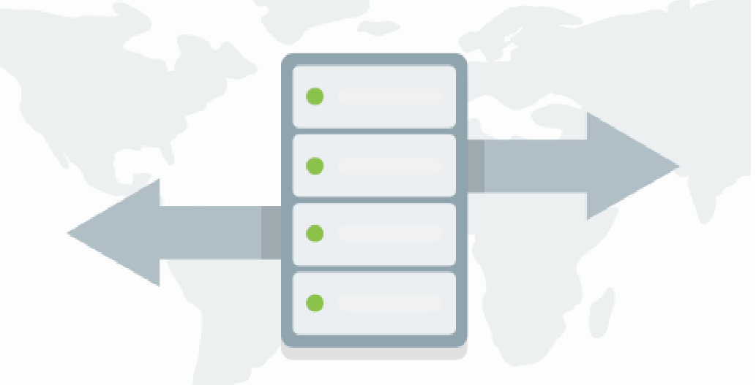
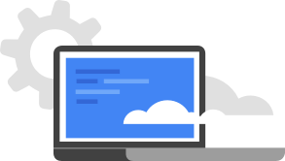

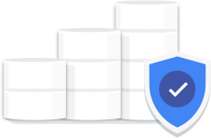
Get the best of relational database structure and non-relational database scale and performance
Scale + SQL
Fully managed
Launch faster
Enterprise grade security
Scales horizontally.
Low latency, transactional consistency, and high availability.
Future-proofs database backends.
Create or scale a globally replicated database in a few clicks.
Synchronous replication and maintenance built in.
Relational semantics.
ACID transactions.
Schemas.
Data-layer encryption.
IAM integration.
Audit logging.
Copyright Google LLC. For educational purposes in accordance with the terms of use set forth on the program Website.
Notes:
Cloud Spanner scales horizontally and serves data with low latency while maintaining transactional consistency and industry-leading 99.999% availability, less than 5 minutes downtime per year. Cloud Spanner can scale to arbitrarily large database sizes to help avoid rewrites and migrations. The use of multiple databases or sharded databases as an alternative solution introduces unnecessary complexity and cost.
Cloud Spanner allows you to create or scale a globally replicated database for mission-critical apps through a handful of clicks. Synchronous replication and maintenance is also automatic and built-in.
Cloud Spanner is a relational database with full relational semantics, ACID transactions, and handles schema changes as an online operation with no planned downtime. You can reuse existing SQL skills to query data in Cloud Spanner using familiar, industry-standard ANSI SQL 2011.
Enterprise grade security includes data-layer encryption by default in transit and at rest, granular identity and access management, and audit logging.

Slide 42
How Cloud Spanner works
Update
Zone 1
Zone 2
Zone 3
Table 1
Table 1
Table 1
Table 2
Table 2
Table 2
Copyright Google LLC. For educational purposes in accordance with the terms of use set forth on the program Website.
Notes:
So how does Cloud Spanner work? Data is automatically and instantly copied across regions, which is called synchronous replication. As a result, queries always return consistent and ordered answers regardless of the region. Google uses replication within and across regions to achieve availability, so if one region goes offline, a user’s data can still be served from another region.

Slide 43
Agenda
Exploring Cloud SQL
Lab: Cloud SQL for MySQL: Qwik Start
Cloud Spanner as a Managed Service
NoSQL Managed Services Options
Datastore, a NoSQL Document Store
Copyright Google LLC. For educational purposes in accordance with the terms of use set forth on the program Website.
Notes:
Now we’ll explore the NoSQL managed services options currently available.

Slide 44
Options for NoSQL based managed services
Datastore
Cloud Bigtable
Copyright Google LLC. For educational purposes in accordance with the terms of use set forth on the program Website.
Notes:
Google offers two managed NoSQL database options.
Datastore is a fully managed, serverless NoSQL document store that supports ACID transactions.
Cloud Bigtable is a petabyte scale, sparse wide column NoSQL database that offers extremely low write latency.
We’ll discuss these managed services in more detail in the topics that follow.

Slide 45
Agenda
Exploring Cloud SQL
Lab: Cloud SQL for MySQL: Qwik Start
Cloud Spanner as a Managed Service
NoSQL Managed Services Options
Datastore, a NoSQL Document Store
Copyright Google LLC. For educational purposes in accordance with the terms of use set forth on the program Website.
Notes:
In this topic, we’ll discuss how Datastore can be used as a NoSQL document store.

Slide 46
Datastore in Google Cloud
Relational
Non-relational
Object
Warehouse
Cloud
SQL
Cloud
Spanner
Datastore
Cloud Bigtable
Cloud
Storage
BigQuery
Copyright Google LLC. For educational purposes in accordance with the terms of use set forth on the program Website.
Notes:
Datastore is a highly-scalable NoSQL database that’s ideal for rapid and flexible web and mobile development. Datastore is a schema-less database, which means it doesn’t rely on a schema the way a relational database does. Datastore is therefore ideal if you have non-relational data and want a serverless database without having to worry about nodes or cluster management. Datastore isn’t a full SQL database though, and isn’t an effective storage solution for data being used for analysis.

Slide 47
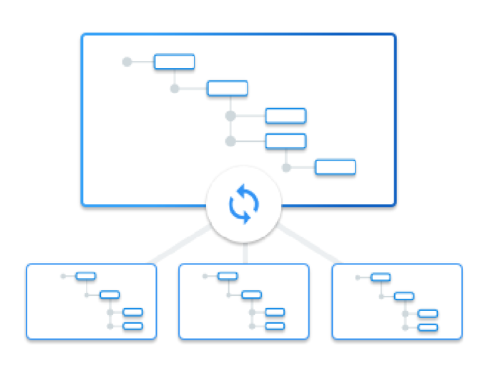
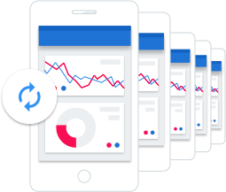
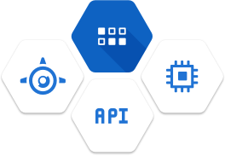
Datastore is a highly available and durable NoSQL database for low-latency serving of data
Schema-less
Fast and highly scalable
Fully managed
Integrated and secure
Change your data structure as your app evolves.
High-speed queries no matter the size of the database.
Seamless scaling.
Instantly provision a scalable and available NoSQL database.
Automatic sharding and replication.
RESTful interface makes data accessible by any deployment target.
Serves as an integration point.
Copyright Google LLC. For educational purposes in accordance with the terms of use set forth on the program Website.
Notes:
Datastore allows you to change to your data structure as your application evolves, so there’s no need to perfect your data model at the beginning of your project. With NoSQL, storing new properties in data requires no database changes or schema.
Datastore serves high-speed queries no matter how big your database, to ensure your applications maintain high performance. Datastore uses Google Query Language (GQL), which, because it's a query language in a SQL-like syntax format, is both familiar and easy to learn. Complex queries are enabled with secondary (called built-ins in Datastore) and composite indexes. It automatically scales to support millions of API requests per second and 100s of terabytes of data, so no configuration or capacity planning is needed.
It’s fully managed by Google so you can instantly provision a scalable and available NoSQL database, without the hassle of spinning up virtual machines and maintaining databases. Datastore automatically handles sharding and replication across multiple datacenters to provide a database that is highly available and durable. This allows users to focus on application development.
With the RESTful interface of Datastore, data can easily be accessed by any deployment target. You can build solutions that run on App Engine, GKE, and Compute Engine and use Datastore as their integration point. Datastore automatically encrypts all data before it is written to disk and automatically decrypts the data when read by an authorized user.

Slide 48
Examples of Datastore use cases
1
User profiles
2
Product catalogues
3
Recording transactions
4
Mobile games
Copyright Google LLC. For educational purposes in accordance with the terms of use set forth on the program Website.
Notes:
Datastore is is the best choice for shifting data requirements without needing downtime, such as user game profiles where flexibility enables rapid development of new features. It’s also ideal for storing user profiles to deliver a customized experience based on the user’s past activities and preferences.
Datastore enables true data hierarchy through ancestor paths, which means related data can be strongly grouped together, making it exceptional for tasks such as storing product reviews or storing the data for an online product catalog that provides real-time inventory and product details for a customer.
Datastore is well suited for recording transactions based on ACID properties, for example, transferring funds from one bank account to another.
For mobile games, Datastore provides a durable key-value store which allows player data to be efficiently stored and accessed. It’s scalability accommodates the growth of games, whether there are 10 players or 100 million.

Slide 49
Agenda
Cloud Bigtable as a NoSQL Option
Quiz
Summary
Copyright Google LLC. For educational purposes in accordance with the terms of use set forth on the program Website.
Notes:
The final topic of this module describes how to leverage Cloud Bigtable as a NoSQL option.

Slide 50
Cloud Bigtable in Google Cloud
Relational
Non-relational
Object
Warehouse
Cloud
SQL
Cloud
Spanner
Datastore
Cloud Bigtable
Cloud
Storage
BigQuery
Copyright Google LLC. For educational purposes in accordance with the terms of use set forth on the program Website.
Notes:
Cloud Bigtable aligns with non-relational database requirements and is a high-performance NoSQL database service for large analytical and throughput-intensive operational workloads. It’s designed for very large amounts of data and is great for IoT, user analytics, financial data analysis, time-series data, and graph data. Bigtable is also an option if support isn’t required for ACID transactions or if the data isn’t highly structured.

Slide 51
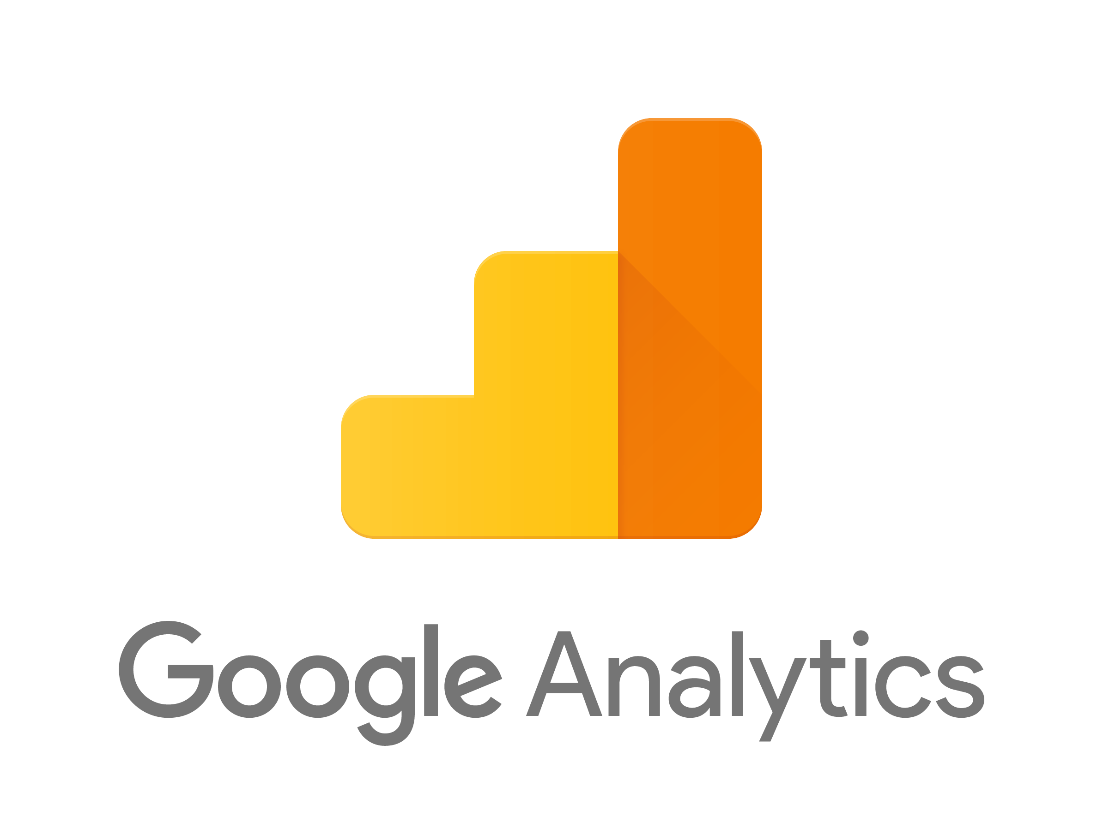
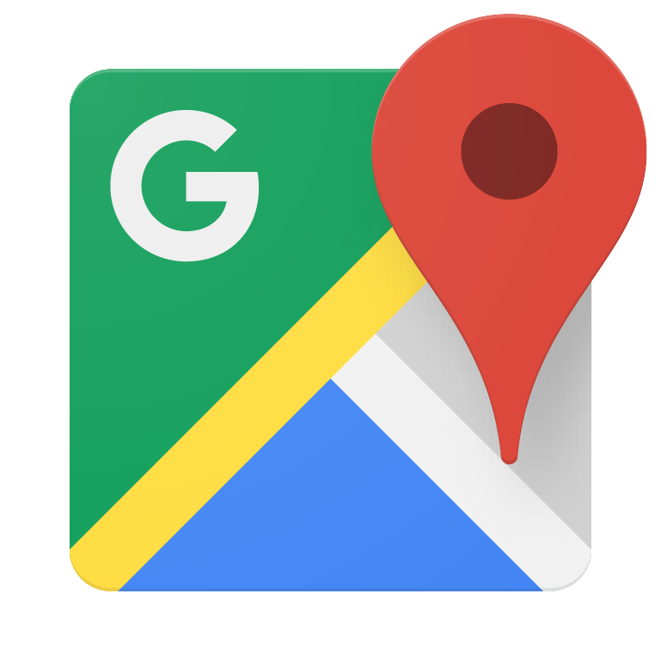
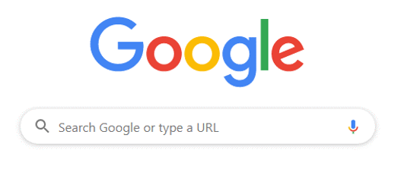
Google uses Cloud Bigtable too!
Copyright Google LLC. For educational purposes in accordance with the terms of use set forth on the program Website.
Notes:
Cloud Bigtable is the same database that powers many of Google's core services, including Analytics, Search, Maps, and Gmail.
Bigtable was an internal Google database system that was so revolutionary it kickstarted the NoSQL industry. Google wanted to build a database that could deliver real-time access to petabytes of data. The result was Bigtable, and in 2006 Google released a research paper describing it. This was later awarded as being one of the most influential papers of the previous decade. This gave people outside of Google ideas that led to the creation of popular NoSQL databases. In 2015, Cloud Bigtable was made available as a service users could use for their own applications.

Slide 52
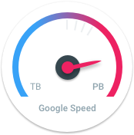
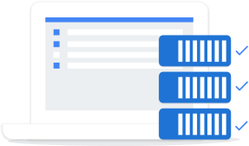
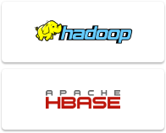
Cloud Bigtable is a fully managed NoSQL database for large analytical and operational workloads
Fast and performant
Seamless scaling and replication
Fully managed
Integrated and secure
High performance under high loads.
Faster, more reliable, and more efficient.
Low latency
Billions of rows and thousands of columns.
No downtime during reconfiguration.
Replication adds high availability.
Database configuration and tuning handled by Google.
Data backups created for disaster recovery.
Integrated with open-source big data tools for powerful data analysis.
Copyright Google LLC. For educational purposes in accordance with the terms of use set forth on the program Website.
Notes:
Because Bigtable offers high performance under high load, large apps and workflows are faster, more reliable, and more efficient running on Bigtable.
Bigtable is ideal for storing large amounts of data with very low latency.
Databases can automatically and seamlessly scale to billions of rows and thousands of columns, allowing you to store petabytes of data. Changes to the deployment configuration are immediate, so there’s no downtime during reconfiguration. Replication adds high availability for live serving apps, and workload isolation for serving versus analytics.
Because Bigtable is a fully managed service, there’s no need to worry about configuring and tuning your database for performance or scalability. Google also creates data backups to protect against catastrophic events and allow for disaster recovery.
You can use Bigtable for a range of applications, from real-time ad analytics all the way to tracking millions of readings from thousands of IoT sensors. Because Bigtable is compatible with industry standard tools like HBase, Hadoop, and BigQuery and Dataflow, it's easy to put all that data to work for your app. In terms of security, all data in Bigtable is encrypted both in-flight and at rest, while access to Bigtable data is easily controlled through IAM permissions.

Slide 53

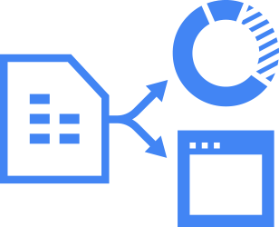


Cloud Bigtable can interact with other Google Cloud services and third-party clients
Application API
Streaming
Batch processing
Copyright Google LLC. For educational purposes in accordance with the terms of use set forth on the program Website.
Notes:
As Bigtable is part of the Google Cloud ecosystem, it can interact with other Google Cloud services and third-party clients.
From an application API perspective, data can be read from and written to Bigtable through a data service layer like Managed VMs, the HBase REST Server, or a Java Server using the HBase client. Typically this will be to serve data to applications, dashboards, and data services.
Data can also be streamed in through a variety of popular stream processing frameworks like Dataflow Streaming, Spark Streaming, and Storm.
If streaming is not an option, data can also be read from and written to Bigtable through batch processes like Hadoop MapReduce, Dataflow, or Spark. Often, summarized or newly calculated data is written back to Bigtable or to a downstream database.

Slide 54
Cloud Bigtable structure
Clients
Processing
Cloud Bigtable node
Cloud Bigtable node
Cloud Bigtable node
Storage
Colossus file system
Copyright Google LLC. For educational purposes in accordance with the terms of use set forth on the program Website.
Notes:
This diagram shows a simplified version of Bigtable overall architecture. It illustrates that processing, which is done through a front-end server pool and nodes, is handled separately from the storage.
A Bigtable table is sharded into blocks of contiguous rows, called tablets, to help balance the workload of queries. Tablets are similar to HBase regions. Tablets are stored on Colossus, which is Google's file system, in a Sorted Strings Table, or SSTable, format. An SSTable provides a persistent, ordered immutable map from keys to values, where both keys and values are arbitrary byte strings.

Slide 55
Scaling Cloud Bigtable
Queries per second
Queries per second
Queries per second
80,000
400,000
4m
60,000
300,000
3m
40,000
200,000
2m
20,000
100,000
1m
0
0
0
0
2
4
6
8
0
10
20
30
40
0
100
200
300
400
Cloud Bigtable nodes
Cloud Bigtable nodes
Cloud Bigtable nodes
Copyright Google LLC. For educational purposes in accordance with the terms of use set forth on the program Website.
Notes:
These charts show that as the required queries per second increase, the nodes required will increase too. The throughput scales linearly, so for every single node that you do add, you're going to see a linear scale of throughput performance, up to hundreds of nodes.

Slide 56
Agenda
Cloud Bigtable as a NoSQL Option
Quiz
Summary
Copyright Google LLC. For educational purposes in accordance with the terms of use set forth on the program Website.

Slide 57
Scenario #1
Question
You are looking for an unstructured storage solution for archiving files that might never be accessed again. Which of the following is the best option?
Cloud Storage Standard class
Datastore
Cloud Storage Archive class
Cloud Bigtable
Copyright Google LLC. For educational purposes in accordance with the terms of use set forth on the program Website.
Notes:
You are looking for an unstructured storage solution for archiving files that might never be accessed again. Which of the following is the best option?

Slide 58
Scenario #1
Answer
You are looking for an unstructured storage solution for archiving files that might never be accessed again. Which of the following is the best option?
Cloud Storage Standard class
Datastore
Cloud Storage Archive class
Cloud Bigtable
Copyright Google LLC. For educational purposes in accordance with the terms of use set forth on the program Website.
Notes:
Cloud Storage Archive storage is designed for long term storage of data that is typically not accessed more than once a year.

Slide 59
Scenario #2
Question
Which of the following is a multi-regional, globally available, managed relational database service?
Datastore
Cloud SQL
Cloud Bigtable
Cloud Spanner
Copyright Google LLC. For educational purposes in accordance with the terms of use set forth on the program Website.
Notes:
Which of the following is a multi-regional, globally available, managed relational database service?

Slide 60
Scenario #2
Answer
Which of the following is a multi-regional, globally available, managed relational database service?
Datastore
Cloud SQL
Cloud Bigtable
Cloud Spanner
Copyright Google LLC. For educational purposes in accordance with the terms of use set forth on the program Website.
Notes:
Cloud Spanner is a multi-regional, globally available managed relational database service.

Slide 61
Scenario #3
Question
How do you scale a Cloud Bigtable database if more queries per second are needed?
Add more nodes
Add more storage
Do nothing, it will scale itself
Export the data and import it into a new Cloud Bigtable cluster
Copyright Google LLC. For educational purposes in accordance with the terms of use set forth on the program Website.
Notes:
How do you scale a Cloud Bigtable database if more queries per second are needed?

Slide 62
Scenario #3
Answer
How do you scale a Cloud Bigtable database if more queries per second are needed?
Add more nodes
Add more storage
Do nothing, it will scale itself
Export the data and import it into a new Cloud Bigtable cluster
Copyright Google LLC. For educational purposes in accordance with the terms of use set forth on the program Website.
Notes:
To add more queries per second to a Cloud Bigtable cluster, simply add more nodes.

Slide 63
Agenda
Cloud Bigtable as a NoSQL Option
Quiz
Summary
Copyright Google LLC. For educational purposes in accordance with the terms of use set forth on the program Website.

Slide 64
Summary (1/2)
Three common use cases for cloud storage include content storage and delivery, storage for data analytics and general compute, and backup and archival storage.
Cloud Storage is suited to the storage of unstructured data.
Standard, Nearline, Coldline, and Archive are classes of Cloud Storage that differ based on how often the data is accessed.
Cloud SQL is a fully managed, relational database service that makes it easy to set up, maintain, manage, and administer relational MySQL, PostgreSQL, and SQL Server databases in the cloud.
Copyright Google LLC. For educational purposes in accordance with the terms of use set forth on the program Website.

Slide 65
Summary (2/2)
Cloud Spanner combines the benefits of relational database structure with non-relational horizontal scale.
Datastore is a highly-scalable NoSQL database that’s ideal for rapid and flexible web and mobile development.
Cloud Bigtable aligns with non-relational database requirements and is a high-performance NoSQL database service for large analytical and throughput-intensive operational workloads.
Copyright Google LLC. For educational purposes in accordance with the terms of use set forth on the program Website.

